Slide 1
Needfinding for Hospital Emergency Rooms
Sujith Guttala - PES1201700445
Tejaswini Amaresh - PES1201700740
Indu Rallabhandi - PES1201700795
Swathi Hebbar - PES1201701826

Slide 2
Focus: Emergency Rooms in Hospitals

Slide 3
Assigning efficient hospital staff
Hospital Emergency Rooms
Treating the patient ASAP
Keeping the Relatives Calm

Slide 4
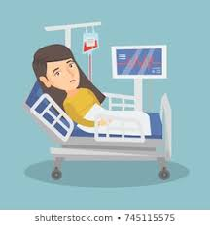


Hospital Staff
Patient
Relatives

Slide 5
Survey
Got general information about people’s perspectives of Emergency rooms
Got a positive response to the idea of an app to help reduce delay in ERs
Got a better idea about what people needed help with
Got a few suggestions as to what can be included in our app to make it more helpful

Slide 6
Our interviewees and how we found them
Local hospital staff (Visited the local hospital)
Patient who has been to an emergency room (Contacts)
Relative of the patient who went to the emergency room (Contacts)

Slide 7
Hospital Staff
What is the number of emergency / ICU cases per day?
What causes delay?
What can help reduce the delay?
Do they start treatment even if the form isn’t filled?

Slide 8
Highlights
Cannot order for tests that help conclude disease without forms being filled
Usually get about 3-5 ICU/Emergency patients a day
Treatment is usually delayed due to shortage of staff or due to delay in filling of forms
Electronic forms could help
Problem: Not every patient is literate, some of the literate ones don’t know English

Slide 9
Patient
How was experience/how they felt?
Was there a delay?
If so what caused it?
How could the experience be better?

Slide 10
Highlights
Reason to visit ER:
Patient 1:
Teeth hit by a golf club
Patient 2:
Hit by an auto-rickshaw
Patient 3:
Heart attack
Scared/Anxious/Nervous
Minimal/No delay
Slight confusion about treatment
More information about procedure, presence of specialised doctors

Slide 11
Relative
What could’ve been done to make them more calm and comfortable?
How was experience/how they felt?
Was there a delay?
If so what caused it?

Slide 12
Highlights
Scared/Anxious/Nervous
Minimal/No delay
Slight confusion about treatment
Help with instant first aid, more information about procedure, presence of specialised doctors

Slide 13
Two empathy maps: hospital staff; patient & relative

Slide 14
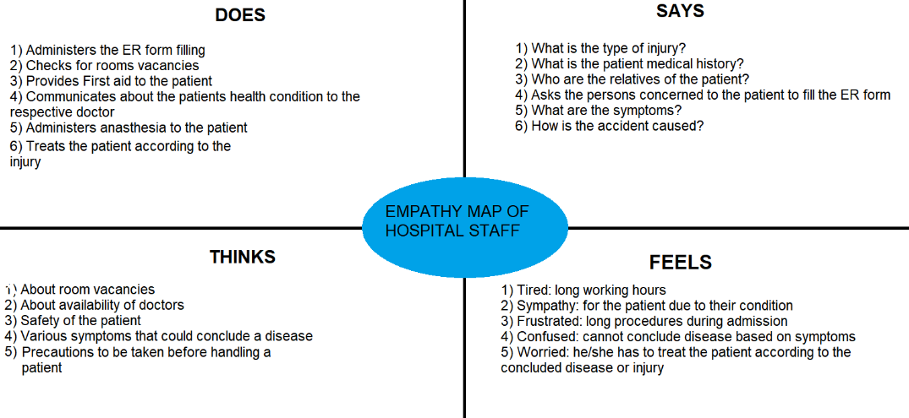
Hospital Staff

Slide 15
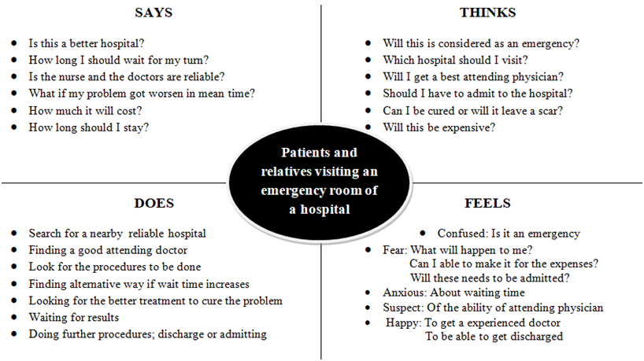
Patient and relative

Slide 16
Inferences
Usually minimal delay
Need reassurance and strength
Need more information about condition
Transparency in hospital procedures

Slide 17
Summary
Need first aid help
Need information about available hospitals
Illiterate patients come to the hospital and can’t fill electronic forms by themselves
Providing detailed medical history of patient beforehand can ensure better treatment

Slide 18
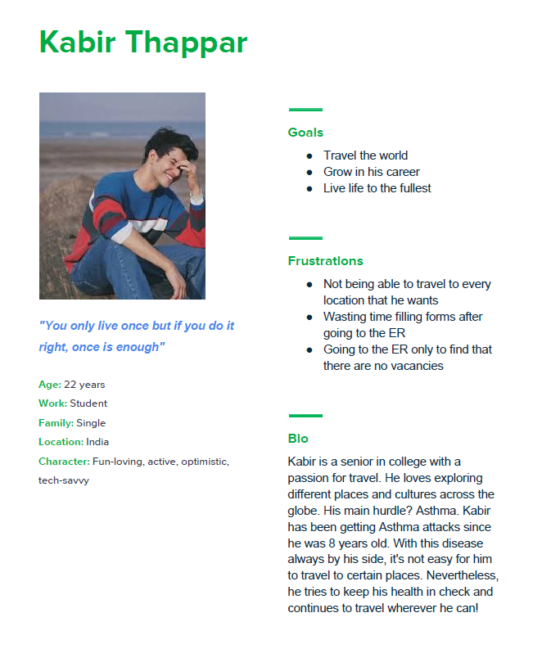
User Persona: Young Adult

Slide 19
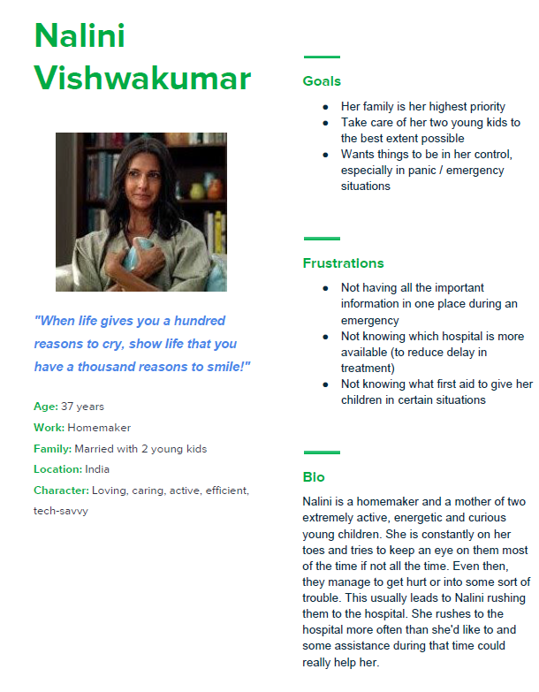
User Persona: Mom

Slide 20
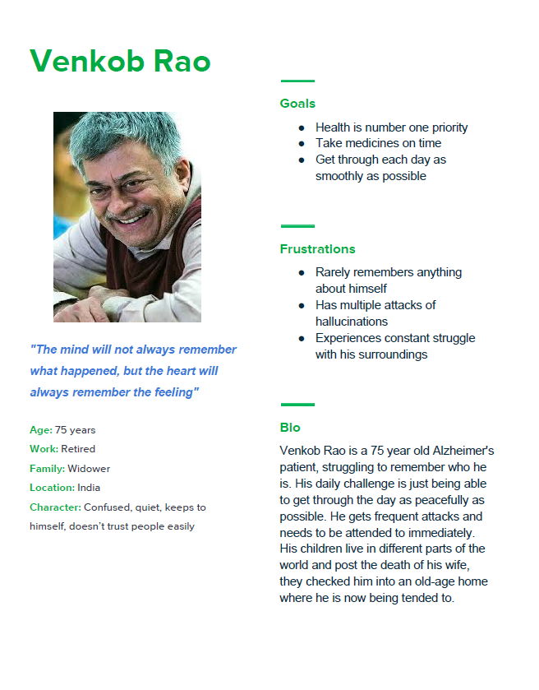
User Persona: Old Man

